Slide 1

Group No. 02
LawGrid : AI Legal Assistant For Antology-Driven Legal Reasoning And Support
Student ID | Group member
23207007 | Ayush Gupta
22107020 | Priyal Madvi
22107042 | Sneha Gupta
23207004 | Rushikesh Palekar
Project Guide
Dr. Pravin Adivarekar
Prof. Harsha Zope

Slide 2
Contents
Abstract
Introduction
Objectives
Literature Review
Research Gap
Problem Definition
Scope
Technological Stack
Proposed System Architecture/Working/Module Diagram
Prototype Design Demonstration
Implementation Status
Review Suggestions (Given in Last meeting)

Slide 3
Abstract
The AI Legal Assistant project integrates AI, NLP, and conversational technology into one platform to simplify legal document creation, review, and understanding. It helps users generate compliant contracts, detect risks in uploaded documents, provide clear explanations, and offer practical solutions. The chatbot enables real-time legal support, while an automated timeline organizes key legal events. This solution streamlines workflows, improves efficiency, and makes legal processes more accessible.

Slide 4
Sustainable Development Goals(SDG) mapped
SDG 16: (Peace, Justice and Strong Institutions)
Helps ensure access to justice by making legal documents, risks, and timelines easier to understand. Supports transparent and efficient legal processes through AI-powered tools.

Slide 5
Introduction
Inefficient contract management and risk identification can lead to costly delays for legal professionals.
Existing legal tools lack personalization and real-time assistance.
Our system provide contract generation, risk detection, and practical solutions with clear explanations.
It includes an interactive chatbot and generates easy-to-understand timelines of legal events.
Motivation
Legal services and tools often provide generic support and manual review, lacking personalized insights.
System provide accurate, customized legal assistance, and clear risk explanations.

Slide 6
Objectives
To review user input and generate accurate contract documents efficiently.
To allow users to upload their contracts, identify any legal or risk issues, and provide clear explanations along with practical solutions to address those risks.
To build a conversational chatbot that functions as a legal assistant, enabling users to communicate their legal needs and comprehend legal information more effectively.
To create an easy-to-understand timeline by automatically finding and arranging important legal events and dates from different documents.

Slide 7
Literature Review
Sr.no | Title | Author(s) | Year | Methodology | Research Gap
1 | Accurate AI Assistance in Contract Law Using Retrieval-Augmented Generation to Advance Legal Technology [1] | Youssra Amazou, Faouzi, Tayalati, Houssam, Mensouri, Abdellah, Azmani, Monir Azmani | 2025 | The methodology is a Retrieval-Augmented Generation (RAG) system that processes legal documents into vector embeddings stored in a database. When a user asks a question, the system retrieves relevant document chunks based on the query and uses them with a Large Language Model (LLM) to generate an answer. | The system's effectiveness is tied directly to the quality and content of its legal databases. If the information is not explicitly available in the legal texts, the system cannot provide an answer and returns "Not applicable".
2 | AI-Powered Legal Documentation Assistant [2] | P. Vimala Imogen, J. Sreenidhi, V. Nivedha | 2024 | The methodology uses HTML, CSS, JavaScript, and PHP for the user interface and backend, with a MySQL database for storing data and templates. The core AI functionality is provided by a Collect.chat-based chatbot that generates documents from templates. | Manually editing contracts, as depicted in the workflow, is a time-consuming and inefficient process that is susceptible to human error, such as typos or inconsistencies, which can lead to significant delays in finalization.

Slide 8
Literature Review
Sr.no | Title | Author(s) | Year | Methodology | Research Gap
3 | Bettercall: AI based legal assistant [3] | Manikrao Dhore, Aryan Vimal, Avish Agrawal, Raghav Bajaj, Rohan Barde | 2024 | The AI legal assistant works in two phases. First, it's trained by converting collected legal documents into vector embeddings and storing them in a database. Second, when a user asks a question, the system converts that query into an embedding and uses Cosine Similarity to find the most relevant legal documents from its database. | The challenge of effectively processing India's multilingual legal data, as much of the content is in regional languages that AI systems may not be fully equipped to handle.The tendency of large language models to provide inaccurate information.
4 | AI-Powered Legal Documentation Assistant[4] | Kuldeep Vayadande, Aditya Bhoyar , Aditi Bhat , Zulfikar Charoliya ,Pranav Bachhav , Aayush Chavan. | 2024 | The system's methodology involves training a ChatGPT 3.5 model with diverse legal documents enhanced by Open AI embeddings. It integrates technologies like PyPDF, Amazon Textract, and langchain for document processing using NLP techniques such as sentiment analysis and Named Entity Recognition (NER) to detect irregularities. | Existing legal tools lack personalization, real-time assistance, and the ability to effectively manage complex contracts. A significant research gap lies in developing integrated systems that offer comprehensive risk detection with clear explanations.

Slide 9
Literature Review
Sr.no | Title | Author(s) | Year | Methodology | Research Gap
5 | LEGAL AI: A Tool to help Lawyers Optimize their Performance[5] | Allan Almeida, Shubh Shah, Neer Bhavesh Khandor, Neha Agarwal | 2024 | The system integrates NER models for redaction, translation models for multilingual accessibility, and LLMs for legal question answering. All modules are connected through semantic indexing and APIs, providing an end-to-end AI legal assistant. | There is no standardized framework for evaluating the quality of legal redaction and translation. Moreover, existing systems rarely combine privacy, translation, and legal QA into one cohesive solution.
6 | AI-Driven Document Automation and Compliance in Contract Lifecycle Management [6] | Sweta Priyadarshni | 2024 | The system uses NLP techniques such as clause extraction and transformer-based models along with machine learning classifiers for compliance checking. It leverages datasets like CUAD and integrates adaptive AI for drafting, review, and compliance monitoring. | Challenges remain in ensuring data privacy, legal explainability, and regulatory adaptability. Existing models are not yet fully reliable for highly dynamic and multi-jurisdictional legal environments.

Slide 10
Literature Review
Sr.no | Title | Author(s) | Year | Methodology | Research Gap
7 | Big data and AI‑driven evidence analysis: a global perspective on citation trends, accessibility, and future research in legal applications [7] | Divya Mehta, Tanvi Malhotra, Arpan Kumar and P.K. Jain | 2023 | The paper presents the methodology uses for Collect.Chat to build an NLP-powered chatbot for document analysis and template recommendations, and a Code Mirror editor for AI-assisted template customization with legal accuracy. | The existing system’s NLP-based chatbot built with Collect.Chat has limited contextual understanding and flexibility compared to an LLM. It focuses on editing predefined templates rather than generating complete legal document formats from scratch, making it less automated and slower in addressing diverse user queries.
8 | An Approach to Get Legal Assistance Using Artificial Intelligence [8] | Nishant Jain and Gaurav Goel | 2023 | The paper proposes a Virtual Legal Assistant using Service-Oriented Architecture with four components: Text Analytics to pre process case data, calculate similarity, and rank results; a Knowledge Base to store rules, models, and rankings; and a Bot Interface for speech/text interaction. | The existing system uses semantic networks, ontologies, Word2Vec/Doc2Vec for a speech-enabled chatbot but is limited to predefined legal case retrieval. Our project uses an LLM-powered chatbot capable of handling diverse legal queries.

Slide 11
Literature Review
Sr.no | Title | Author(s) | Year | Methodology | Research Gap
9 | Artificial Intelligence and Law: An Effective and Efficient Instrument [9] | Dr. Hemlata Sharma and Aakanksha | 2020 | The paper presents a descriptive and analytical approach to studying Artificial Intelligence in the legal sector. It combines literature review, thematic analysis, and case studies to examine AI applications in various branches of law, compare India’s framework with global practices, and propose policy recommendations. | Limited to theory and policy, with no practical AI tools for contract review or risk detection. Lacks interactive chatbot support and automated legal timeline generation.
10 | Use of Artificial Intelligence to Analyse Risk in Legal Documents for a Better Decision Support [10] | Dipankar Chakrabarti, Neelam Patodia, Udayan Bhattacharya, Indranil Mitra, Satyaki Roy, Jayanta Mandi, Nandini Roy, Prasun Nandy | 2018 | The AI system uses Retrieval-Augmented Generation (RAG), where legal documents are stored as vector embeddings in a database. When a user poses a query, the system retrieves relevant chunks using similarity search and generates responses through a Large Language Model (LLM). | The system’s accuracy depends heavily on the quality and scope of the legal database. If the required legal information is missing or incomplete, the model cannot provide useful answers.

Slide 12
Research Gap(Limitations of existing systems)
No Automated Contract Generation: Existing systems lack to create complete, accurate documents from user input.
No Risk Detection in Uploaded Contracts: System do not analyse uploaded contracts to provide practical solutions.
Limited Chatbot Intelligence: Existing chatbots rely on basic NLP and cannot handle diverse legal queries.
No Automated Legal Timeline: Systems do not arrange important legal dates into a structured timeline.

Slide 13
Problem Definition
Legal docs = Complex. Slow. Hard to understand.
Problem: Jargon + no user-friendly tools
Need: An intelligent system to simplify workflows
Solution: Auto contracts, risk alerts, clear explanations, chatbot support
Result: Faster. Smarter. Accessible.
Key points to address :
Plain-language explanations
Timeline generation of legal events
User-friendly AI and NLP integration
Legal workflow efficiency and transparency

Slide 14
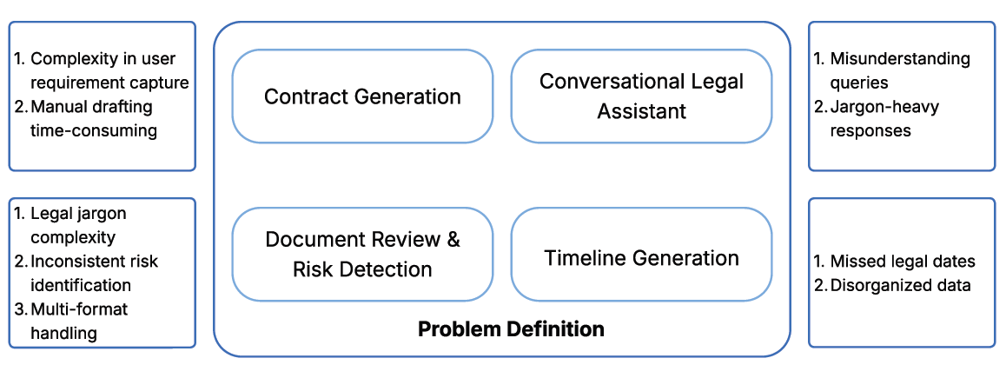
Problem Definition
Figure 1: Problem Definition Diagram

Slide 15
Scope
Designed for everyone: individuals, small businesses, and legal professionals.
Eliminates legal jargon with clear, plain-language explanations.
Provides smart assistance through chatbot, document review, and summaries.
Makes legal processes faster, easier, and more transparent.

Slide 16
Technological Stack
Front-end:
HTML5, CSS3, JavaScript
Back-end:
Flask: For handling contract review, risk analysis, and timeline generation requests.
AI Legal Engine:
AI LLM Model: chatbot assistance.
Datasets:
> IndicLegalQA Dataset_10K 4854KB
> IndicLegalQA Dataset_10K_Revised 4881KB
> indian_kanoon_cases 2KB
Rule-based Approach (Regular Expressions – re): For extracting important legal events and dates.
NLP (spaCy, NLTK): For chronological arrangement of legal case events from contracts and case laws.
Legal-BERT / RoBERTa (Hugging Face): For domain-specific risk classification and fine-tuned analysis.
PyMuPDF / pdfplumber, python-docx: For extracting text from PDF files and Microsoft Word documents

Slide 17
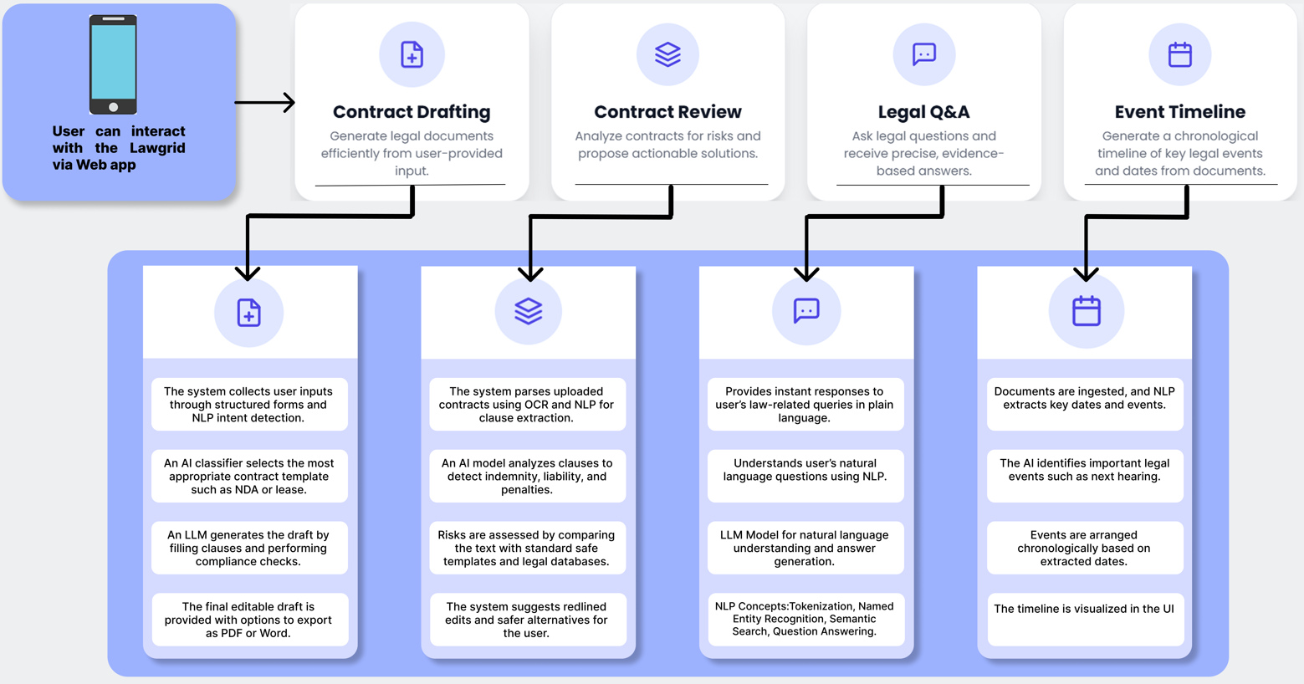
Proposed system architecture
Figure 2: Proposed system architecture

Slide 18
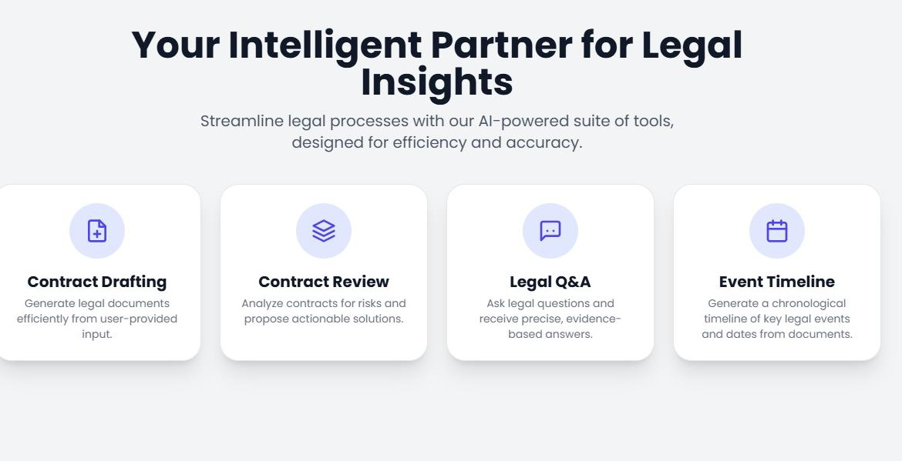
Prototype Design Demonstration
Figure 3: Homepage ( From where we navigate to other features)

Slide 19
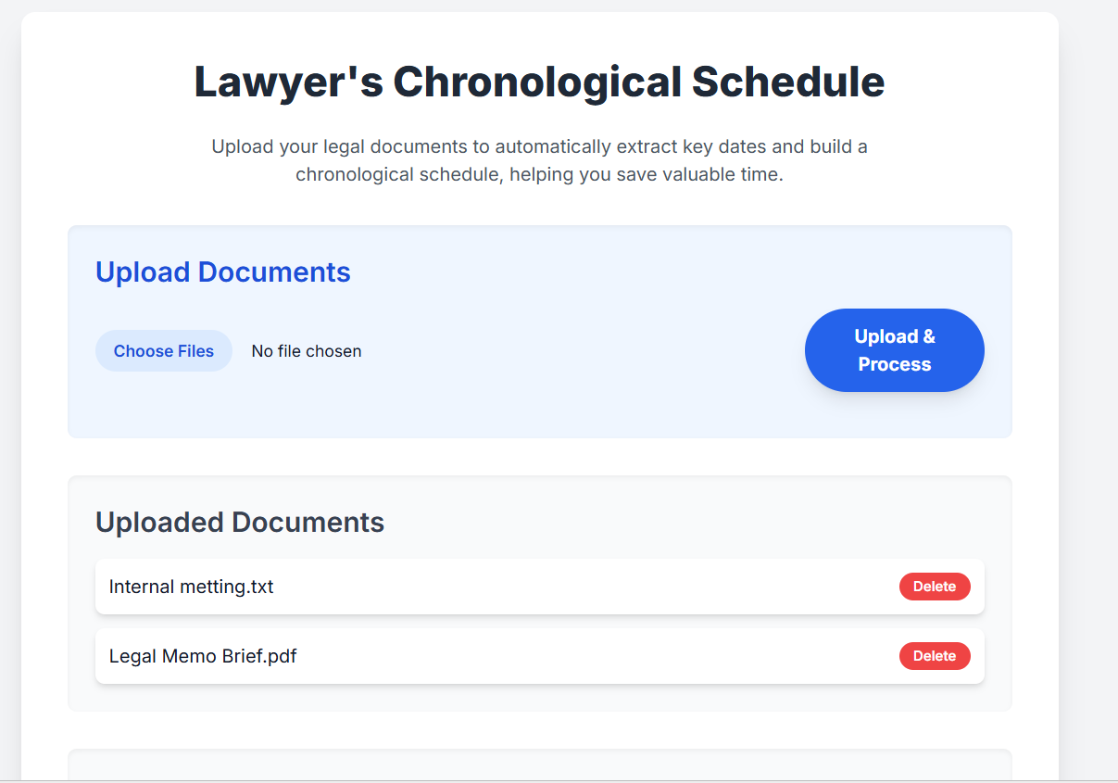
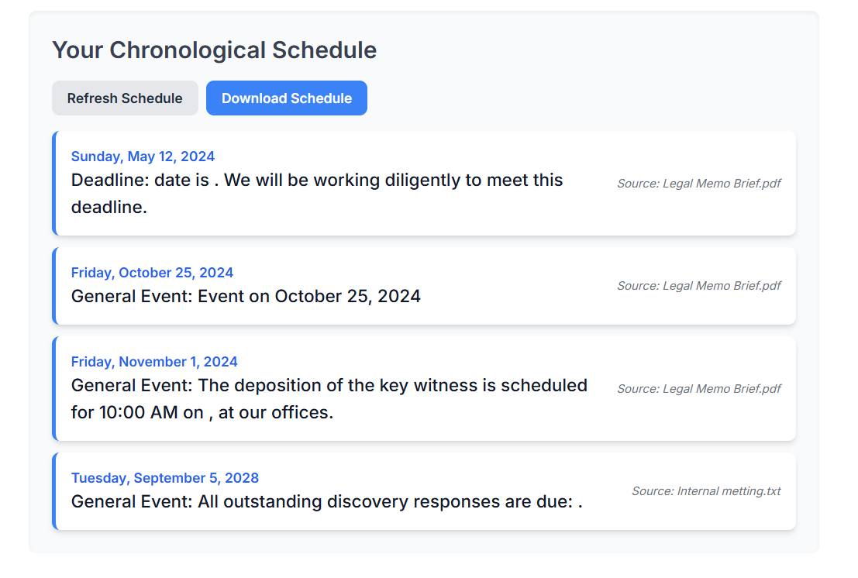
Prototype Design Demonstration
Figure 4: Lawyer’s Event Timeline

Slide 20
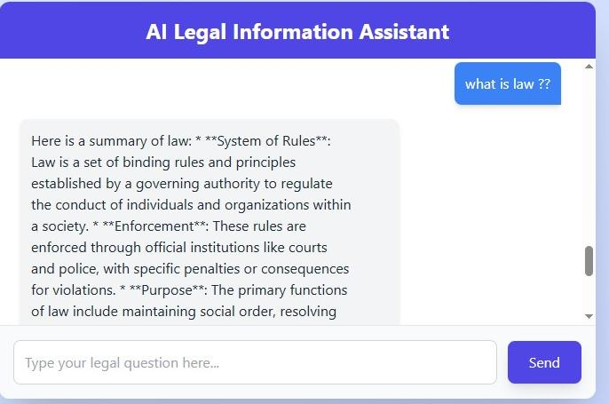
Implementation Status
Figure 5: AI Law Assistance Chatbot
Figure 6: Lawyer Event Timeline

Slide 21
Review Suggestions (Given in Last meeting)
Not Applicable for Review 1

Slide 22
References
Youssra Amazou, Faouzi, Tayalati, Houssam, Mensouri, Abdellah, Azmani, Monir Azmani , Accurate AI Assistance in Contract Law Using Retrieval-Augmented Generation to Advance Legal Technology , Vol 16, No 2, 2025, ResearchGate.
P. Vimala Imogen, J. Sreenidhi, V. Nivedha , AI-Powered Legal Documentation Assistant , ISSN: 2582-2012 , 2024 , ResearchGate.
Manikrao Dhore, Aryan Vimal, Avish Agrawal, Raghav Bajaj, Rohan Barde, Bettercall: AI based legal assistant , 2024, International Conference on Image Processing and Capsule Networks (ICIPCN).
Kuldeep Vayadande, Aditya Bhoyar , Aditi Bhat , Zulfikar Charoliya ,Pranav Bachhav , Aayush Chavan, AI-Powered Legal Documentation Assistant, 2024, International Conference on Pervasive Computing and Social Networking (ICPCSN).
Allan Almeida, Shubh Shah, Neer Bhavesh Khandor, Neha Agarwal, LEGAL AI: A Tool to help Lawyers Optimize their Performance, 2024, IEEE.
Sweta Priyadarshni, AI-Driven Document Automation and Compliance in Contract Lifecycle Management, 2024, IEEE.

Slide 23
References
Divya Mehta, Tanvi Malhotra, Arpan Kumar and P.K. Jain, Big data and AI‑driven evidence analysis: a global perspective on citation trends, accessibility, and future research in legal applications , 2023 , IEEE.
Nishant Jain and Gaurav Goel, An Approach to Get Legal Assistance Using Artificial Intelligence , 2023, IEEE .
Dr. Hemlata Sharma and Aakanksha, Artificial Intelligence and Law: An Effective and Efficient Instrument , 2020, IEEE.
Dipankar Chakrabarti, Neelam Patodia, Udayan Bhattacharya, Indranil Mitra, Satyaki Roy, Jayanta Mandi, Nandini Roy, Prasun Nandy, Use of Artificial Intelligence to Analyse Risk in Legal Documents for a Better Decision Support, 2018, IEEE.

Slide 24
Thank You...!!

